Slide 1



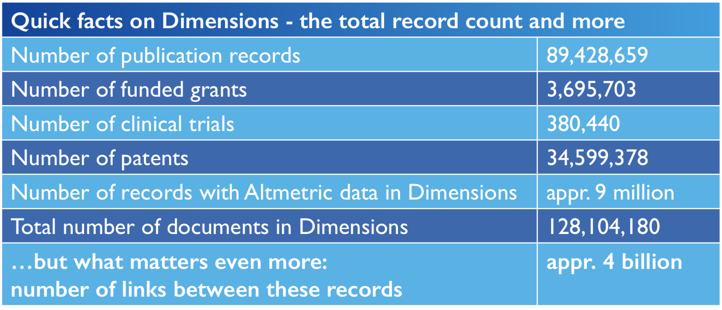
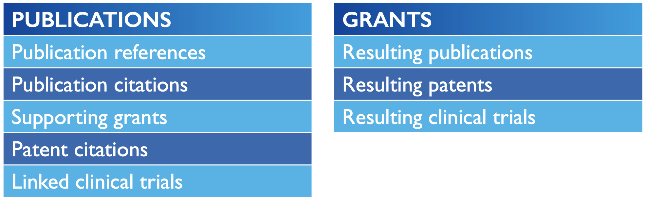
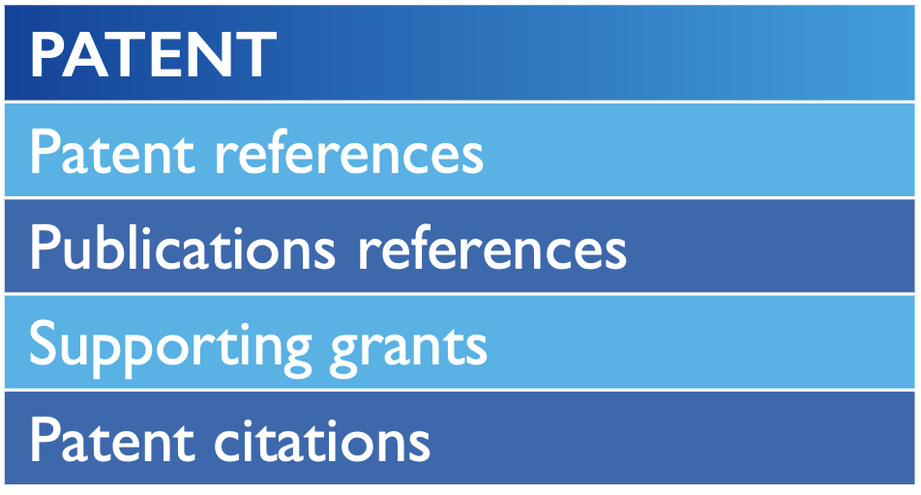
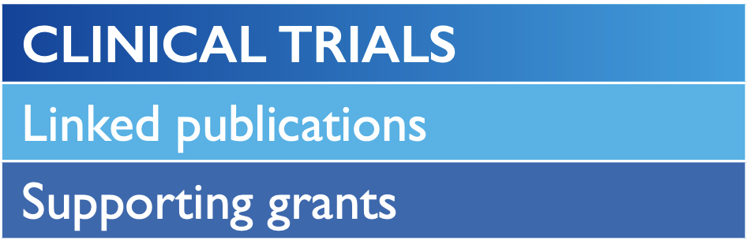
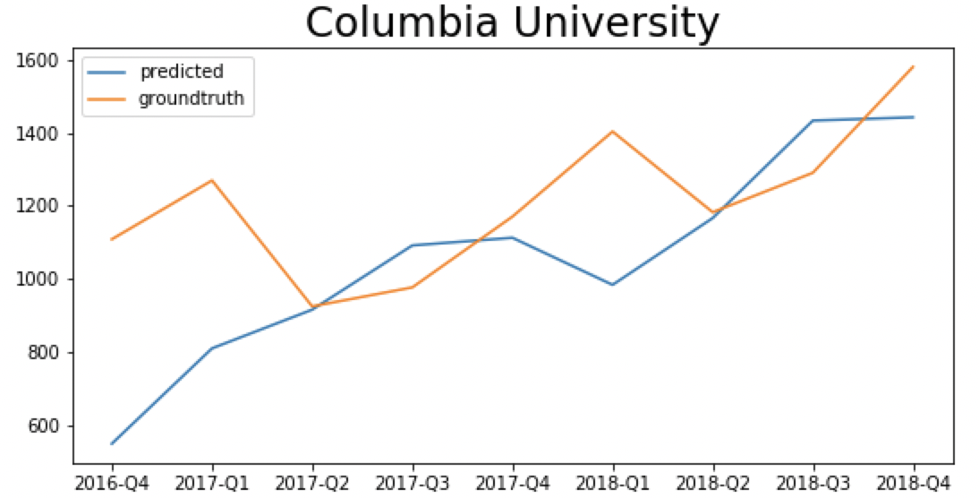
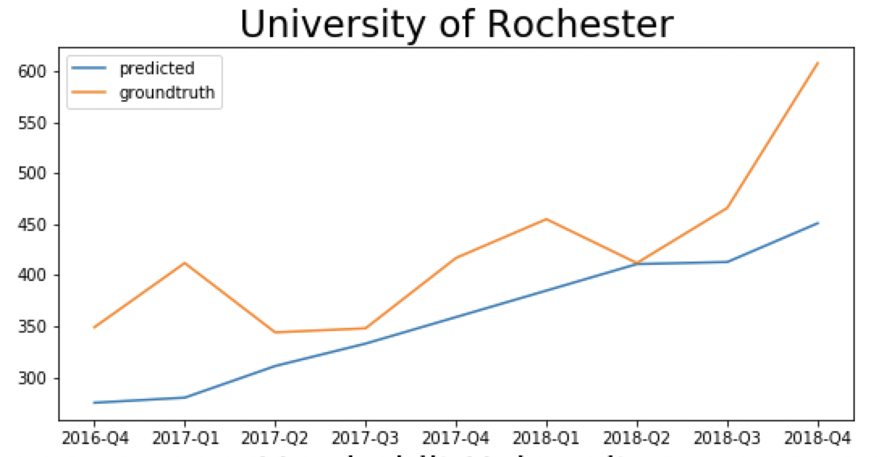
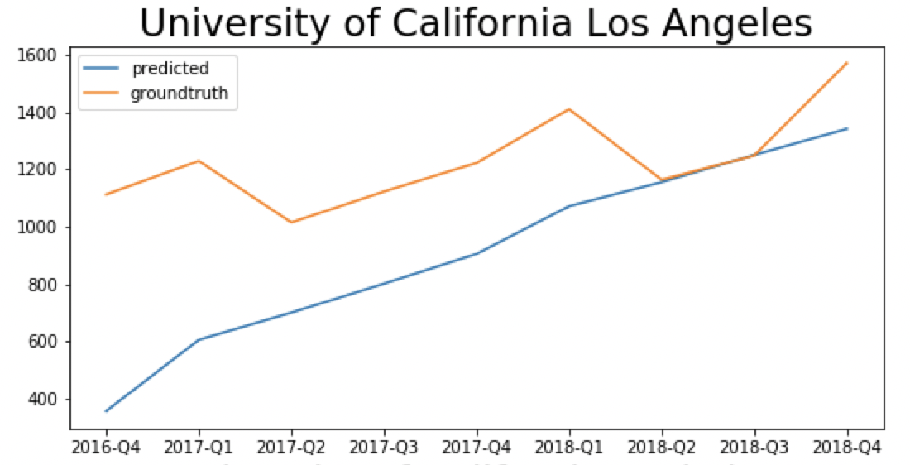
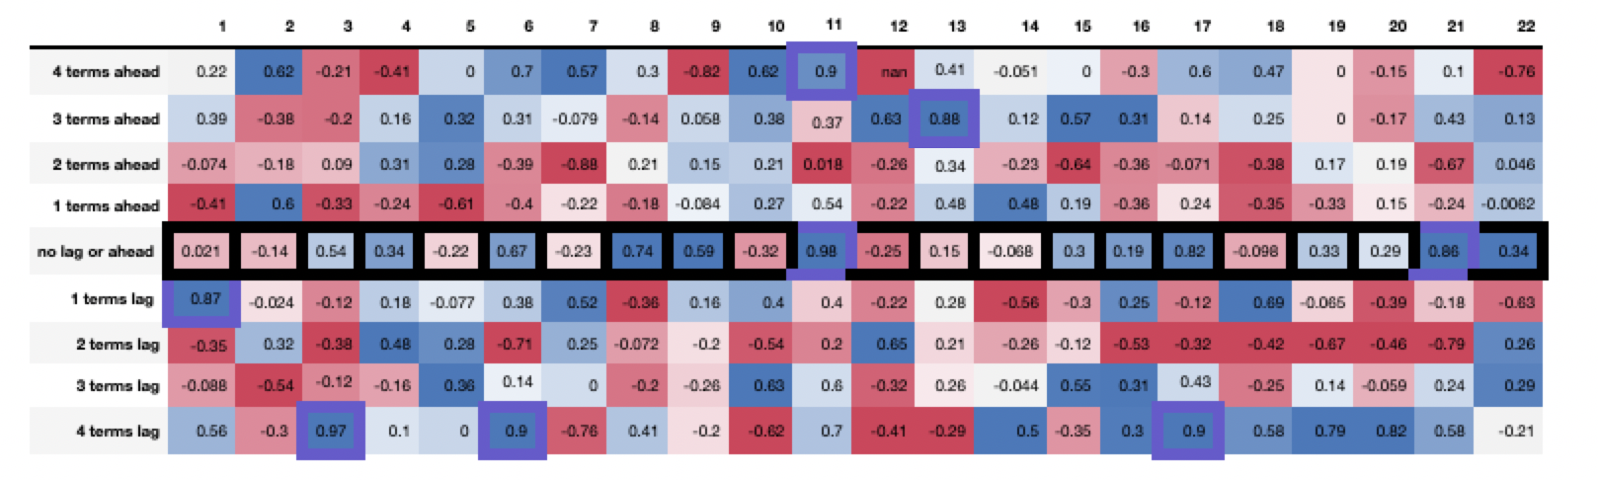
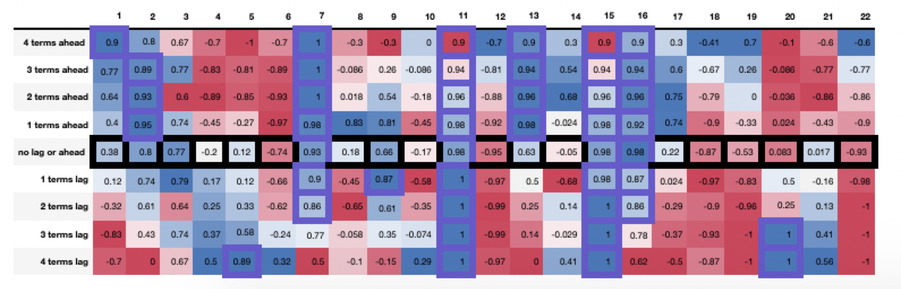
A Machine-Learning Approach to Estimating a Higher Education Institution’s Standing in the Academic Research Landscape
Meizhu Wang, Dale P. Hess
University of Rochester, Rochester NY
Yue Zhao, Edgar A. Bernal
Rochester Data Science Consortium, Rochester, NY
;
ABSTRACT
DATASET OVERVIEW
Most of the current university ranking methodologies leverage reputational data extracted from surveys performed across populations of interest, usually including educators; however, it has been argued that the outcomes of such studies are skewed towards favoring a few selected institutions due to intrinsic human bias. Further, university rankings provide a static snapshot into the layout of the academic landscape, which we believe can better be understood if thought of as a dynamic entity. In this work, we introduce a data-based approach to constructing time-dependent snapshots of the global academic research landscape. To that end, we leverage the Dimensions dataset, a collaborative data platform that catalogs publications, grants, patents, and clinical trials, as well as connections among them. We query Dimensions to build global- and institution-level temporal research trends. We then compute cross-correlations with varying lags across the extracted temporal trends to determine whether an institution is ahead, on par or behind a given reference trend. Lastly, we leverage long-short-term memory networks (LSTM) to predict the future path of research trends, which enables us to anticipate the evolution of a given institution’s standing in a particular field.
RESULTS ON HISTORICAL DATA
BACKGROUND
Traditional university rankings based on reputational data extracted from surveys
Results affected by human subjectivity and bias
Rankings represent a static snapshot of current landscape
Goal is to build framework for data-based ranking of universities
Objective
Dynamic/time-dependent
UofR vs. Brown
UofR ahead in FoRs 2, 6 and 9
Brown ahead in FoRs 3, 11, 17
Pretty even elsewhere
UofR vs. Yale
UofR ahead in FoRs 6 and 16
Yale ahead in FoRs 2, 3, 11 and 17
Pretty even elsewhere
La
PROPOSED APPROACH
Query Dimensions dataset across 22 Fields of Research (FoR)
Build institution-level and aggregate temporal research trends
Compute Pearson correlation across resulting time series at different lags
Lag at which peak correlation occurs indicative of relative standing
Use Long-Short-Term-Memory (LSTM) networks to predict future trends
Predict evolution of institutional standing in a given FoR
FoRs include
RESULTS ON PREDICTED DATA
Plots on right show predicted vs. real trends on held out future data for FoR 11
Plots below show predicted vs. real comparison trends across FoRs
.
Mathematical Sciences | Architecture and Design
Physical Sciences | Education
Chemical Sciences | Economics
Earth Sciences | Commerce/Management/Tourism
Environmental Sciences | Studies in Human Society
Biological Sciences | Psychology/Cognitive Sciences
Agricultural/Veterinary Sciences | Law/Legal Studies
Information/Computing Sciences | Creative Arts/Writing
Engineering | Language/Communication/Culture
Technology | History/Archaeology
Medical/Health Sciences | Philosophy/Religious Studies
DISCUSSION
Predicted
Proposed objective, data-based metric to determine relative standings
Proposed machine learning framework to predict future behavior of research trends
Next steps:
Compare results with those of publicly available rankings
Devise prescriptive analytics to suggest course of action given desired outcome
Real
Notes:
MADIVISION 01 MATHEMATICAL SCIENCES DIVISION 02 PHYSICAL SCIENCES DIVISION 03 CHEMICAL SCIENCES DIVISION 04 EARTH SCIENCES DIVISION 05 ENVIRONMENTAL SCIENCES DIVISION 06 BIOLOGICAL SCIENCES DIVISION 07 AGRICULTURAL AND VETERINARY SCIENCES DIVISION 08 INFORMATION AND COMPUTING SCIENCES DIVISION 09 ENGINEERING DIVISION 10 TECHNOLOGY DIVISION 11 MEDICAL AND HEALTH SCIENCES DIVISION 12 BUILT ENVIRONMENT AND DESIGN DIVISION 13 EDUCATION DIVISION 14 ECONOMICS DIVISION 15 COMMERCE, MANAGEMENT, TOURISM AND SERVICES DIVISION 16 STUDIES IN HUMAN SOCIETY DIVISION 17 PSYCHOLOGY AND COGNITIVE SCIENCES DIVISION 18 LAW AND LEGAL STUDIES DIVISION 19 STUDIES IN CREATIVE ARTS AND WRITING DIVISION 20 LANGUAGE, COMMUNICATION AND CULTURE DIVISION 21 HISTORY AND ARCHAEOLOGY DIVISION 22 PHILOSOPHY AND RELIGIOUS STUDIES
1

